Slide 1



A guide by Houda Bakir
houda.bakir@datavora.com
Notes:
Me , a year , opportunité de travailler dessus

Slide 2



DATA PREPARATION
Data Science Pipeline
Tools to use
Numpy
Scipy
Pandas
matplotlib
Notes:
Commencez avec Presentation de Datavora ,
Introduction de ML
C’est quoi machine learning Machine learning CLasses

Slide 3

Agenda
Learning Objectives
Why should I prepare my data?
What types of data might I encounter?
How can Python help me?

Slide 4
Learning Objectives
Understand the importance of preparing your data for analysis
Understand different types of data formats you may encounter
Understand strategies and techniques for importing, preparing, and saving your data using Python

Slide 5
Why should I prepare my data?
Reduce errors
Remove duplicate records
Fix missing values
Correct range values
Fix formatting (i.e. date, text, number)

Slide 6
What types of data formats might I encounter?
Comma Separated Value (CSV)
Excel
JavaScript Object Notation (JSON)
Structured Query Language (SQL)
And more!
Python can help

Slide 7

Pandas
Key Python Package:
Pandas
Open source library that allows you to work with CSV, Excel, JSON, and SQL database files, pull them into tables (called dataframes), and perform various data analysis techniques.

Slide 8
Coding Basics
Some basic python syntax to keep in mind:
Declaring a variable (always to the left of equal sign)
File names (can use “ “ or ‘ ‘)
dataframe = pd.read_excel(‘file_name.xlsx', ‘sheet_name’)
Or
file_name = ‘file_name.xlsx’
sheet_name = ‘sheet_name’
dataframe = pandas.read_excel(file_name, sheet_name)

Slide 9
Coding Basics (cont.)
Some basic python syntax to keep in mind:
Using library packages
Import pandas as pd #calling pandas library and creating reference ‘pd’
dataframe = pd.read_excel(‘file_name.xlsx', ‘sheet_name’)
Or
dataframe = pandas.read_excel(‘file_name.xlsx', ‘sheet_name’)

Slide 10
Overview
Python Library to provide data analysis features similar to: R, MATLAB, SAS
Rich data structures and functions to make working with data structure fast, easy and expressive.
It is built on top of NumPy
Key components provided by Pandas:
Series
DataFrame
from pandas import Series, DataFrame
import pandas as pd

Slide 11
Series
One dimensional array-like object
It contains array of data (of any NumPy data type) with associated indexes. (Indexes can be strings or integers or other data types.)
By default , the series will get indexing from 0 to N where N = size -1
obj = Series([4, 7, -5, 3])
obj
Out[667]:
0 4
1 7
2 -5
3 3
dtype: int64
obj.values
array([ 4, 7, -5, 3], dtype=int64)
In [669]: obj.index
Out[669]: RangeIndex(start=0, stop=4, step=1)

Slide 12
Series – referencing elements
In [670]: obj2 = Series([4, 7, -5, 3], index=['d', 'b', 'a', 'c'])
In [671]: obj2
Out[671]:
d 4
b 7
a -5
c 3
dtype: int64
In [674]: obj2['a']
Out[674]: -5
In [675]: obj2['d']=10
In [677]: obj2[['d', 'c', 'a']]
Out[677]:
d 10
c 3
a -5
dtype: int64
In [672]: obj2.index
Out[672]: Index(['d', 'b', 'a', 'c'], dtype='object')
In [673]: obj2.values
Out[673]: array([ 4, 7, -5, 3], dtype=int64)
In [692]: obj2[:2]
Out[692]:
d 10
b 7
dtype: int64

Slide 13
Series – array/dict operations
numpy array operations can also be applied, which will preserve the index-value link
Can be thought of as a dict. Can be constructed from a dict directly.
In [699]: obj2**2
Out[699]:
d 100
b 49
a 25
c 9
dtype: int64
In [694]: obj2[obj2>0]
Out[694]:
d 10
b 7
c 3
dtype: int64
In [702]: obj3 = Series({'a': 10, 'b': 5, 'c': 30})
In [703]: obj3
Out[703]:
a 10
b 5
c 30
dtype: int64
In [700]: 'b' in obj2
Out[700]: True

Slide 14
Series – null values
In [708]: pd.isnull(obj4)
Out[708]:
Texas False
Ohio False
Oregon False
Iowa True
dtype: bool
In [704]: sdata = {'Texas': 10, 'Ohio': 20, 'Oregon': 15, 'Utah': 18}
In [705]: states = ['Texas', 'Ohio', 'Oregon', 'Iowa']
In [706]: obj4 = Series(sdata, index=states)
In [707]: obj4
Out[707]:
Texas 10.0
Ohio 20.0
Oregon 15.0
Iowa NaN
dtype: float64
In [709]: pd.notnull(obj4)
Out[709]:
Texas True
Ohio True
Oregon True
Iowa False
dtype: bool
Missing value
In [717]: obj4[obj4.notnull()]
Out[717]:
Texas 10.0
Ohio 20.0
Oregon 15.0
dtype: float64

Slide 15
Series – auto alignment
In [707]: obj4
Out[707]:
Texas 10.0
Ohio 20.0
Oregon 15.0
Iowa NaN
dtype: float64
In [714]: obj5
Out[714]:
Ohio 20
Oregon 15
Texas 10
Utah 18
dtype: int64
In [715]: obj5 + obj4
Out[715]:
Iowa NaN
Ohio 40.0
Oregon 30.0
Texas 20.0
Utah NaN
dtype: float64

Slide 16
Series name and index name
In [722]: obj4.index.name = 'state'
In [723]: obj4
Out[723]:
state
Texas 10.0
Ohio 20.0
Oregon 15.0
Iowa NaN
Name: population, dtype: float64
In [720]: obj4.name = 'population'
In [721]: obj4
Out[721]:
Texas 10.0
Ohio 20.0
Oregon 15.0
Iowa NaN
Name: population, dtype: float64
In [725]: obj4.index = ['Florida', 'New York', 'Kentucky', 'Georgia']
In [726]: obj4
Out[726]:
Florida 10.0
New York 20.0
Kentucky 15.0
Georgia NaN
Name: population, dtype: float64
Index of a series can be changed to a different index.
Index object itself is immutable.
In [1014]: obj4.index[2]='California'
TypeError: Index does not support mutable operations
In [1016]: obj4.index
Out[1016]: Index(['Florida', 'New York', 'Kentucky', 'Georgia'], dtype='object')

Slide 17
DataFrame
In [727]: data = {'state': ['Ohio', 'Ohio', 'Ohio', 'Nevada', 'Nevada'],
...: 'year': [2000, 2001, 2002, 2001, 2002],
...: 'pop': [1.5, 1.7, 3.6, 2.4, 2.9]}
In [728]: frame = DataFrame(data)
In [729]: frame
Out[729]:
pop state year
0 1.5 Ohio 2000
1 1.7 Ohio 2001
2 3.6 Ohio 2002
3 2.4 Nevada 2001
4 2.9 Nevada 2002
A DataFrame is a tabular data structure comprised of rows and columns, akin to a spreadsheet or database table.
It can be treated as an order collection of columns
Each column can be a different data type
Have both row and column indices
reordered

Slide 18
DataFrame – specifying columns and indices
In [727]: data = {'state': ['Ohio', 'Ohio', 'Ohio', 'Nevada', 'Nevada'],
...: 'year': [2000, 2001, 2002, 2001, 2002],
...: 'pop': [1.5, 1.7, 3.6, 2.4, 2.9]}
Order of columns/rows can be specified.
Columns not in data will have NaN.
In [730]: frame2 = DataFrame(data, columns=['year', 'state', 'pop', 'debt'], index=['A', 'B', 'C', 'D', 'E'])
In [731]: frame2
Out[731]:
year state pop debt
A 2000 Ohio 1.5 NaN
B 2001 Ohio 1.7 NaN
C 2002 Ohio 3.6 NaN
D 2001 Nevada 2.4 NaN
E 2002 Nevada 2.9 NaN
Same order
Initialized with NaN

Slide 19
DataFrame – from nested dict of dicts
Outer dict keys as columns and inner dict keys as row indices
In [838]: pop = {'Nevada': {2001: 2.9, 2002: 2.9}, 'Ohio': {2002: 3.6, 2001: 1.7, 2000: 1.5}}
In [840]: frame3 = DataFrame(pop)
In [841]: frame3
Out[841]:
Nevada Ohio
2000 NaN 1.5
2001 2.9 1.7
2002 2.9 3.6
Transpose
In [842]: frame3.T
Out[842]:
2000 2001 2002
Nevada NaN 2.9 2.9
Ohio 1.5 1.7 3.6
Union of inner keys (in sorted order)

Slide 20
DataFrame – index, columns, values
In [850]: frame3.index.name = 'year'; frame3.columns.name='state'
In [851]: frame3
Out[851]:
state Nevada Ohio
year
2000 NaN 1.5
2001 2.9 1.7
2002 2.9 3.6
In [847]: frame3.index
Out[847]: Int64Index([2000, 2001, 2002], dtype='int64')
In [848]: frame3.columns
Out[848]: Index(['Nevada', 'Ohio'], dtype='object')
In [849]: frame3.values
Out[849]:
array([ [ nan, 1.5],
[ 2.9, 1.7],
[ 2.9, 3.6]])

Slide 21
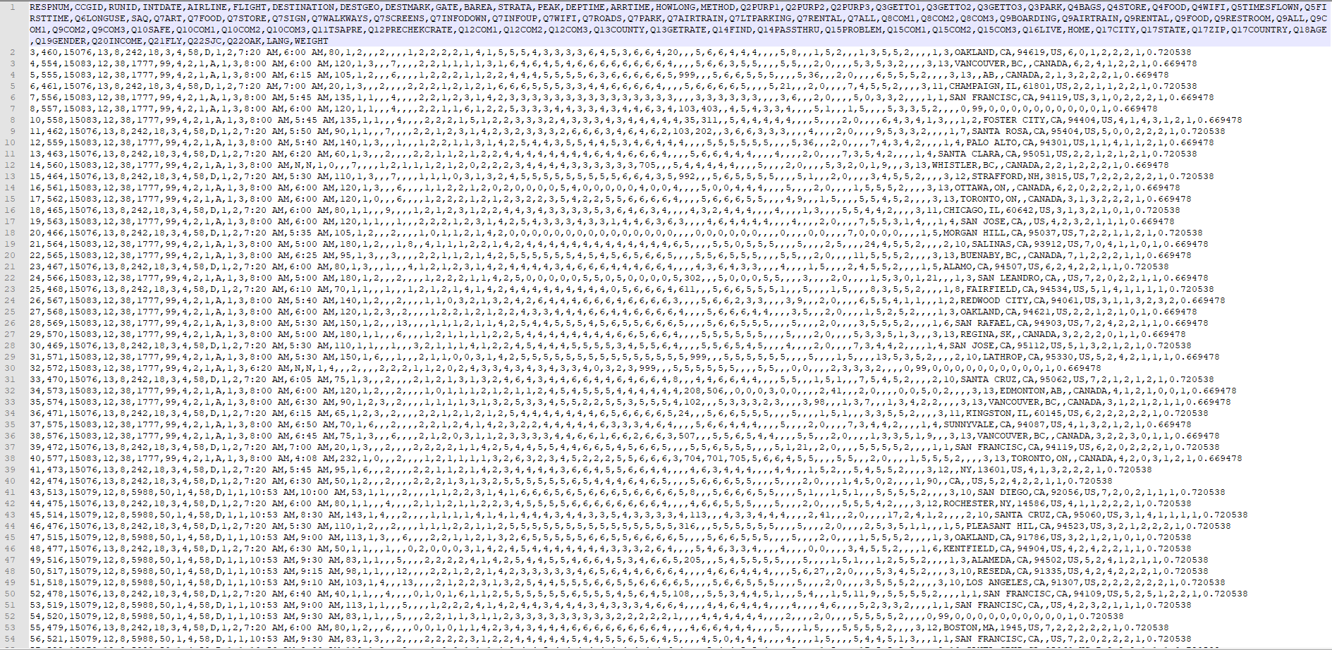
CSV Example
SFO Airport Survey Results

Slide 22
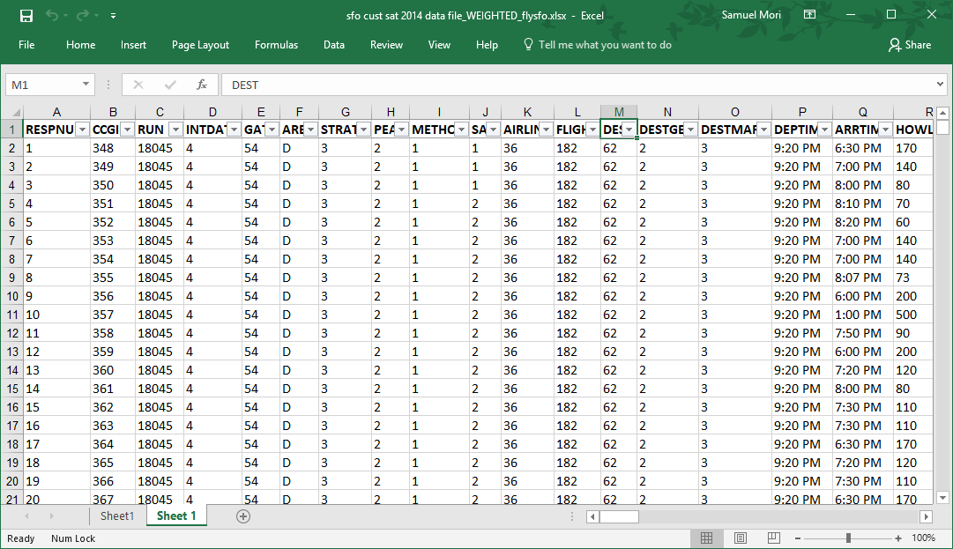
Excel Example
SFO Airport Survey Results

Slide 23
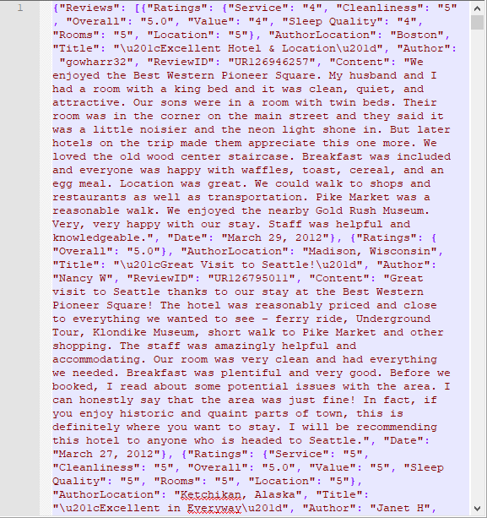
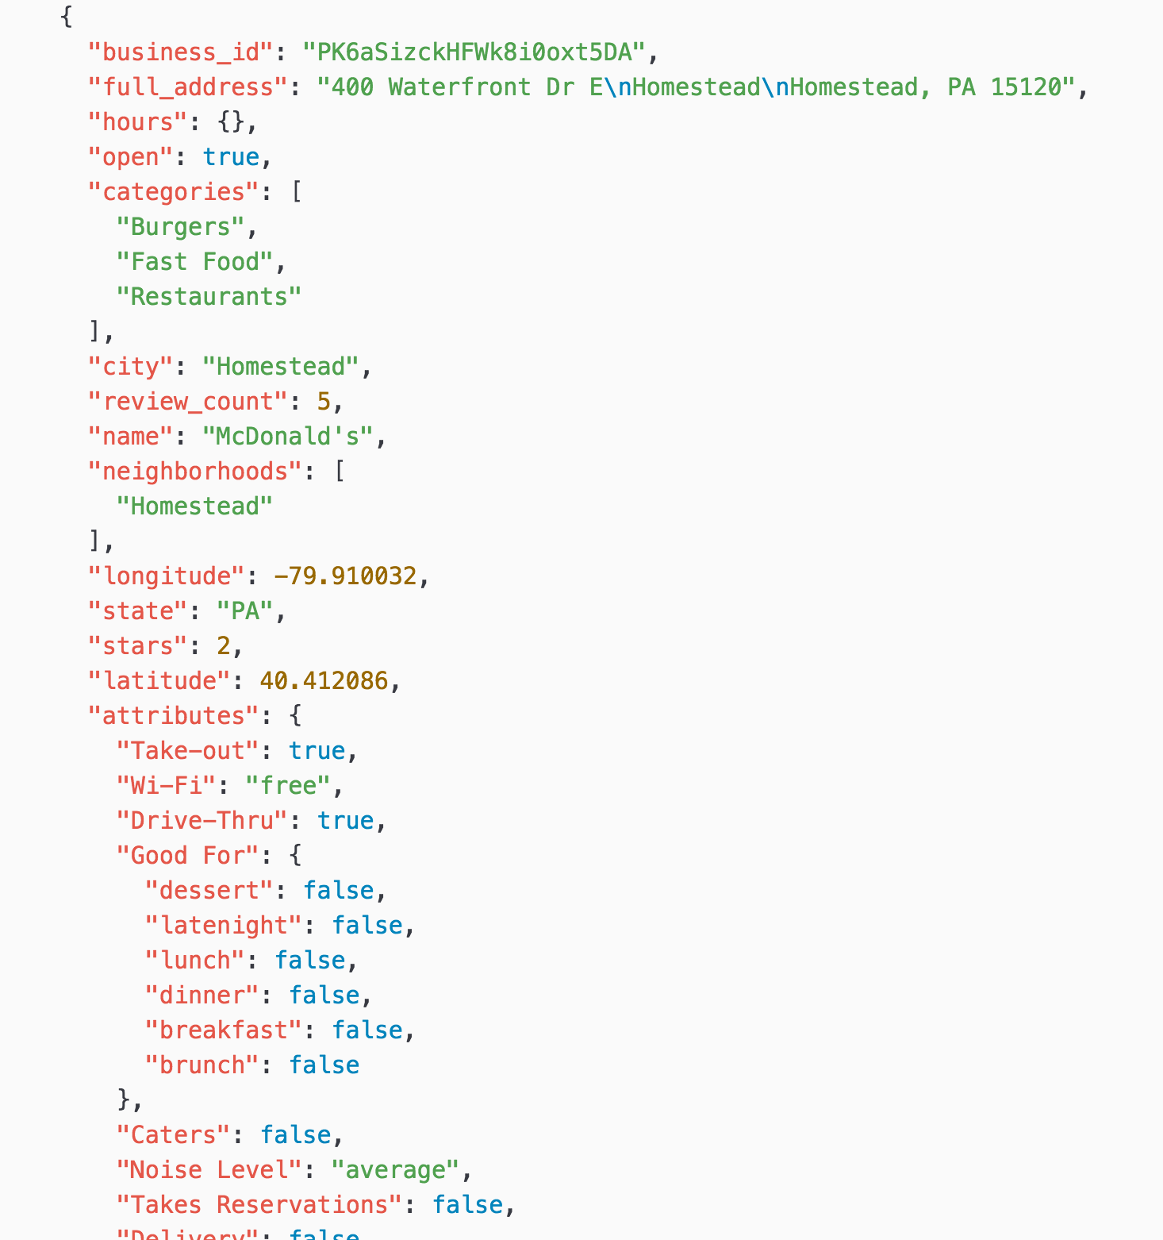
JSON Examples
Trip Advisor JSON file
Yelp JSON file

Slide 24
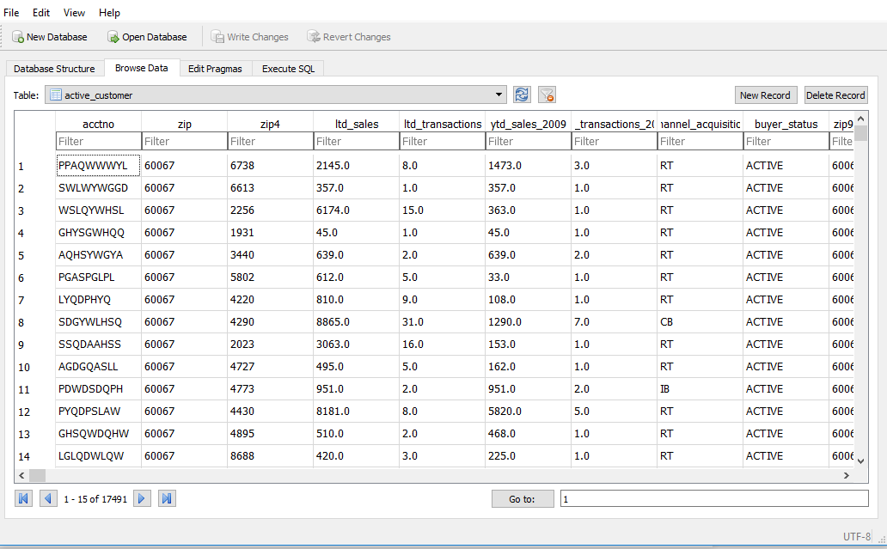
SQL Example
Sample Customer Data

Slide 25
Case Study
Datavora example Data – Excel & CSV files

Slide 26
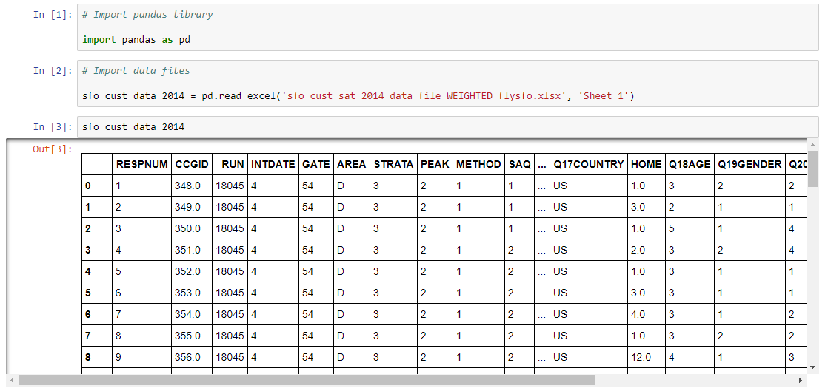
Importing the Data
How do I import an Excel file?

Slide 27
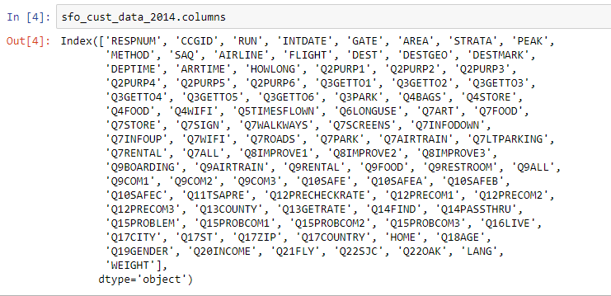
Data Characteristics
What columns do we have?

Slide 28
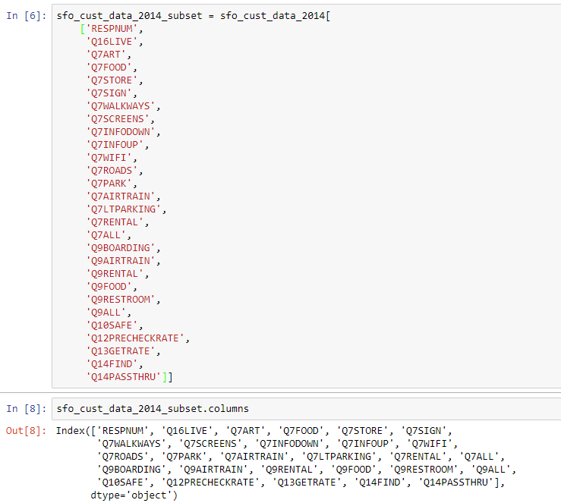
Data Characteristics
What if I just want a subset of these columns?

Slide 29
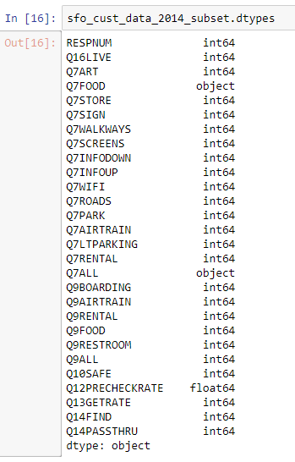
Data Characteristics
What columns do I have and what are their data types?

Slide 30
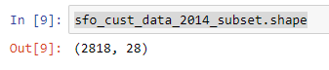
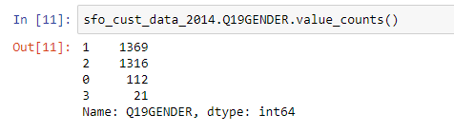
Data Characteristics
How many columns and records do I have?
Can I do a count of different values within a column?

Slide 31
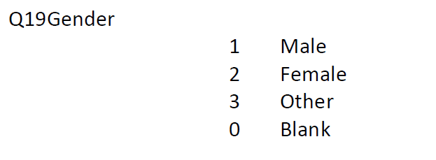
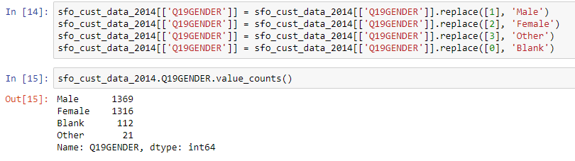
Modifying Data Values
Lets look at the data dictionary
How do I replace values to make them meaningful?

Slide 32
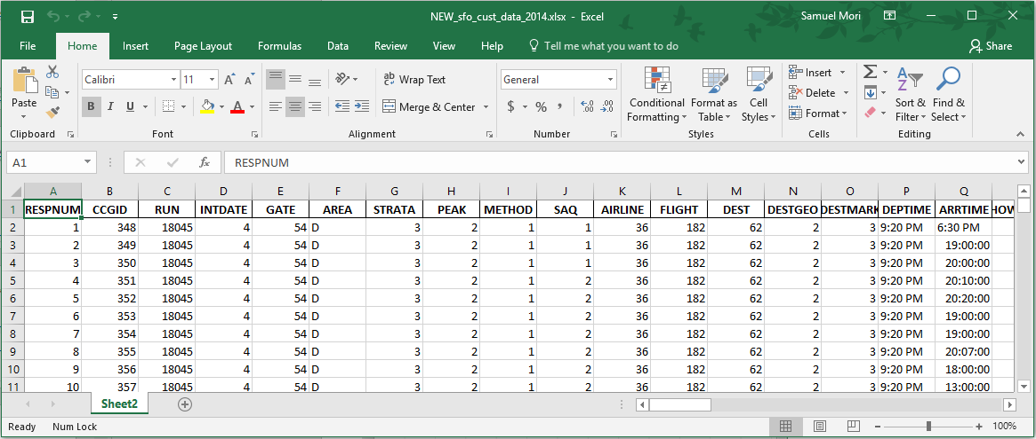
Saving to Excel
How do I save this new file?
What does my file look like?

Slide 33
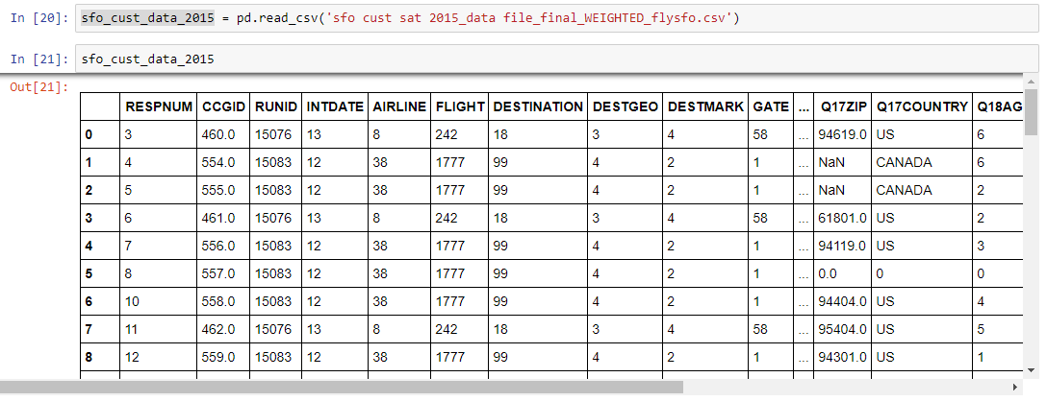
Importing the Data
How do I import a CSV file?
What is NaN?

Slide 34
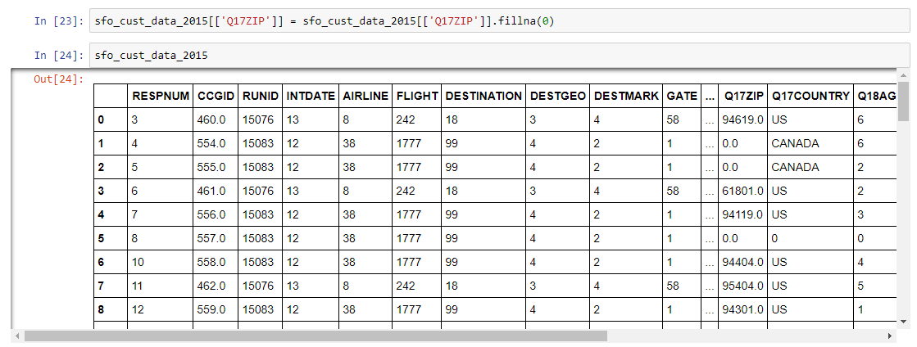
Fixing Error Values
How do I fix NaN values?

Slide 35
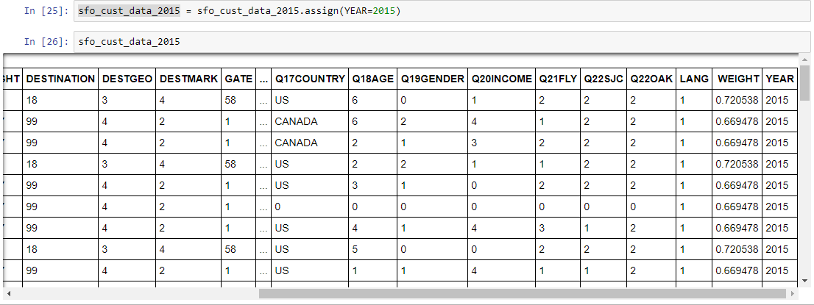
Adding Custom Columns
What if I want to add the Year in a column?

Slide 36
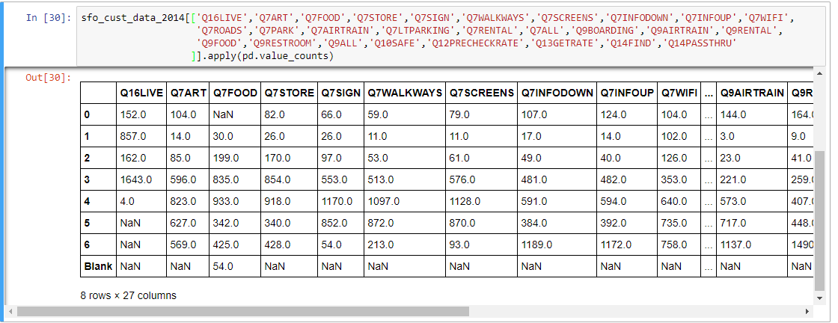
Identifying Value Ranges
How do I look at the data value ranges for multiple columns?

Slide 37
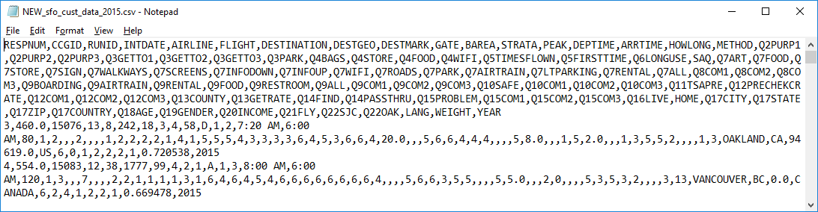
Saving to CSV
How do I save this new file?
What does my file look like?

Slide 38
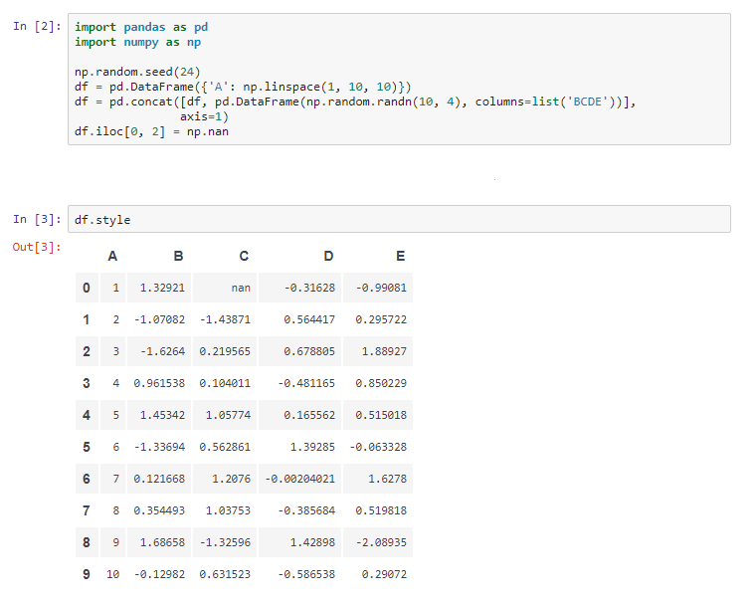
DFStyle

Slide 39
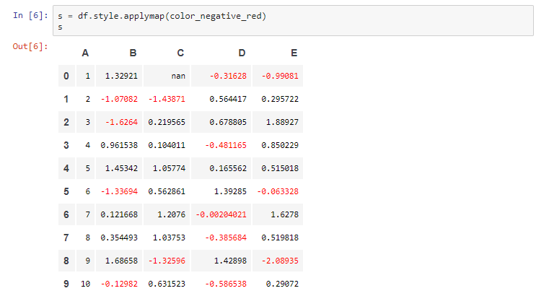
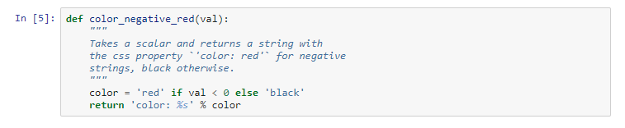
DFStyle

Slide 40
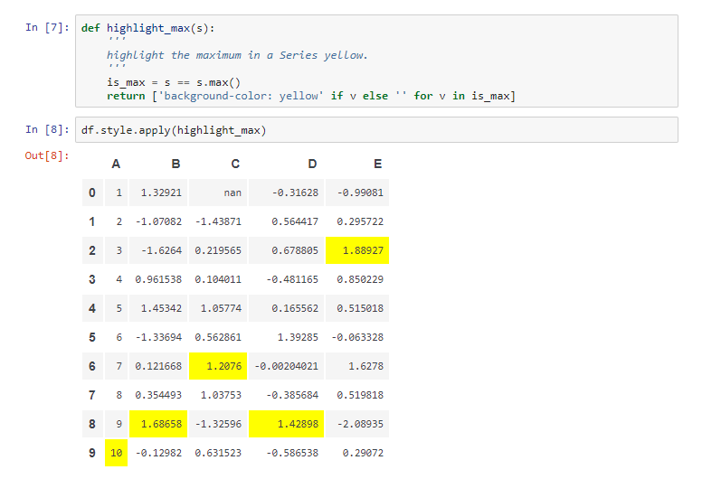
DFStyle

Slide 41
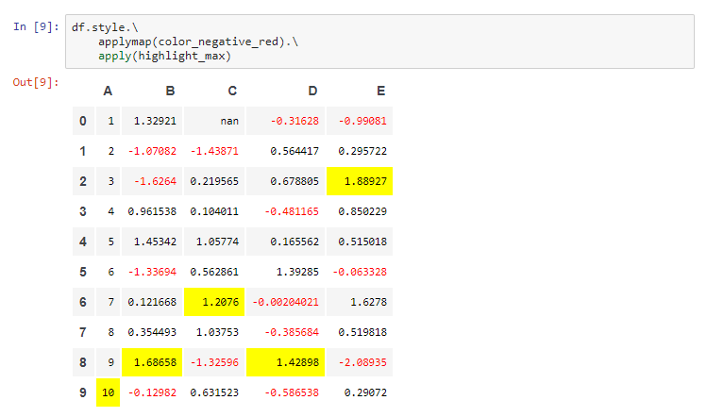
DFStyle

Slide 42
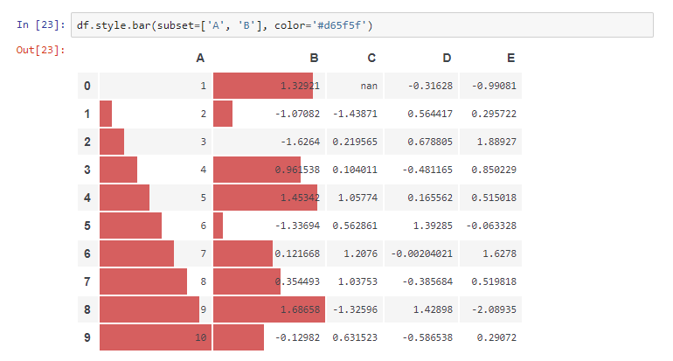
DFStyle

Slide 43
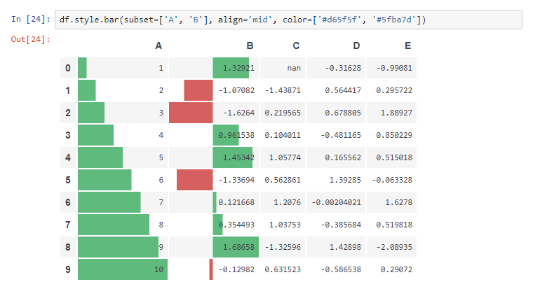
DFStyle

Slide 44
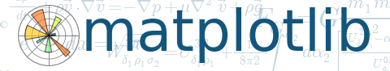
Plotting - matplotlib
User friendly, but powerful, plotting capabilities for python
http://matplotlib.sourceforge.net/
Once installed (default at Observatory)
import pylab
Settings can be customised by editing ~/.matplotlib/matplotlibrc
default font, colours, layout, etc.
Helpful website
many examples
Notes:
‹#›
‹#›

Slide 45
Pylab and Pyplot
$ python
Python 2.7.3 (default, Aug 9 2012, 17:23:57)
[GCC 4.7.1 20120720 (Red Hat 4.7.1-5)] on linux2
Type "help", "copyright", "credits" or "license" for more information.
import matplotlib.pyplot as plt
plt.plot([1,2,3,4])
[<matplotlib.lines.Line2D object at 0x1fe53d0>]
plt.ylabel('some numbers')
<matplotlib.text.Texy object at 0x1d6ad90>
plt.show()
$ ipython –-pylab
Python 2.7.3 (default, Aug 9 2012, 17:23:57)
Type "copyright", "credits" or "license" for more information.
IPython 0.13.2 -- An enhanced Interactive Python.
? -> Introduction and overview of IPython's features.
%quickref -> Quick reference.
help -> Python's own help system.
object? -> Details about 'object', use 'object??' for extra details.
Welcome to pylab, a matplotlib-based Python environment [backen: GTKAgg].
For more information, type ‘help(pylab)’
In [1]: plot([1,2,3,4])
Notes:
‹#›

Slide 46
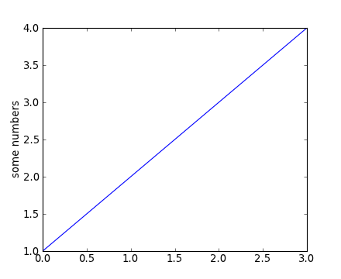
Matplotlib.pyplot basic example
matplotlib.pyplot is a collection of command style functions that make matplotlib work like MATLAB. Each pyplot unction makes some change to a figure: eg, create a figure, create a plotting area in a figure, plot some lines in a plotting area, decorate the plot with labels, etc....
import matplotlib.pyplot as plt plt.plot([1,2,3,4])
plt.ylabel('some numbers')
plt.show()
Notes:
‹#›
‹#›

Slide 47
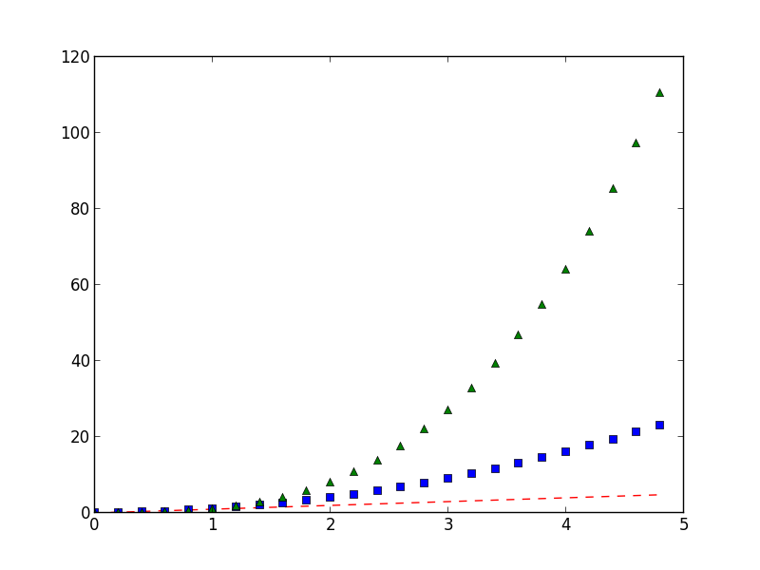
Matplotlib.pyplot basic example
Generally, you will use numpy arrays. In fact, all sequences are converted to numpy arrays internally. The example below illustrates a plotting several lines with different format styles in one command using arrays.
import numpy as np
import matplotlib.pyplot as plt
# evenly sampled time at 200ms intervals
t = np.arange(0., 5., 0.2)
# red dashes, blue squares and green triangles plt.plot(t, t, 'r--', t, t**2, 'bs', t, t**3, 'g^')
Notes:
‹#›
‹#›

Slide 48
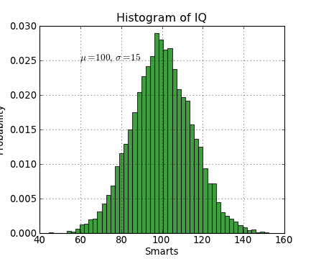
Matplotlib.pyplot example
import numpy as np
import matplotlib.pyplot as plt
mu, sigma = 100, 15
x = mu + sigma * np.random.randn(10000)
# the histogram of the data
n, bins, patches = plt.hist(x, 50, normed=1, facecolor='g', alpha=0.75)
plt.xlabel('Smarts')
plt.ylabel('Probability')
plt.title('Histogram of IQ')
plt.text(60, .025, r'$\mu=100,\ \sigma=15$')
plt.axis([40, 160, 0, 0.03])
plt.grid(True)
Working with text.
The text() command can be used to add text in an arbitrary location, and the xlabel(), ylabel() and title() are used to add text in the indicated locations.
Notes:
‹#›
‹#›

Slide 49
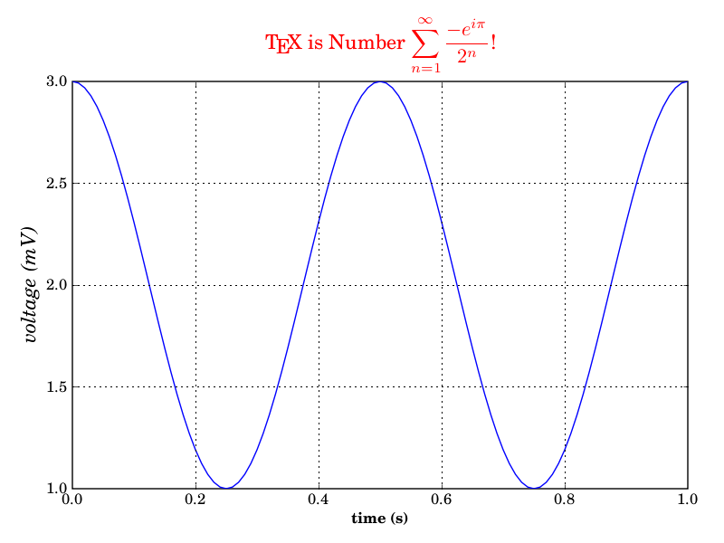
Matplotlib.pyplot example
Using TeX.
from matplotlib import rc
from matplotlib.numerix import arange, cos, pi
from pylab import figure, axes, plot, xlabel,
ylabel, title, grid, savefig, show
rc('text', usetex=True)
figure(1)
ax = axes([0.1, 0.1, 0.8, 0.7])
t = arange(0.0, 1.0+0.01, 0.01)
s = cos(2*2*pi*t)+2
plot(t, s)
xlabel(r'\textbf{time (s)}')
ylabel(r'\textit{voltage (mV)}',fontsize=16)
title(r"\TeX\ is Number $\displaystyle\sum_{n=1}^\infty\frac{-e^{i\pi}}{2^n}$!", fontsize=16, color='r')
grid(True)
savefig('tex_demo')
show()
Notes:
‹#›
‹#›

Slide 50
Questions?

